Slide 1

You are installing your first windows!
Rtx 4090
Usb to install windows 11
Boot

Slide 2
You are installing your first windows!
Rtx 4090
Boot

Slide 3
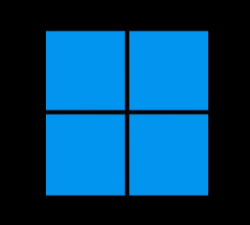

Slide 4
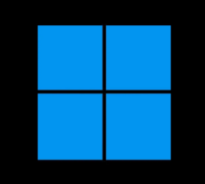
Windows Setup
Welcome To Windows
Next

Slide 5
US
MORE COMING SOON S
Next

Slide 6
9:09
Saturday January 7

Slide 7

Sign in

Slide 8


Search

Slide 9
Search
edge
Search

Slide 10
search
youtube
Search
edge

Slide 11
Youtube.com
More tommorow
Search
edge

